Slide 1
Accenture Responsibilities

Slide 2
In Brief - Explanations
With our experience and expertise in the Application Environment Support (Infrastructure Outsourcing) space in the areas of infrastructure management, release management, configuration management and production support.
Kaiser’s NPS BSC teams at IDC have been heavily engaged in providing IO services for over 7+ years. While we have been able to construct thorough IO processes that enables us deliver defect-free jobs, we have also been able to build a pool of experts including DBA, Websphere Administration and other specialized application administration skills.
Being engaged on a larger scale will motivate the current team with extended jobs on other health plans.
Alongside, it will also provide the much required career path for this team with niche/ unique skills and support retention of team members within the group.

Slide 3
Services offered
Application Infrastructure Management
Release management
Configuration management
Production Support
IT Security Services

Slide 4
Application Infrastructure Management
Description –
Application infrastructure, comprised of application servers, web servers, and often database servers, is a core component in most network architectures.
Application infrastructure provides a powerful platform to support and extend a broad range of application services from small, task oriented and limited scale applications, to large, advanced e-commerce transaction systems supporting thousands of users.
Allow organizations to integrate, manipulate and deliver data from a variety of backend solutions including databases, web based applications, and web-enabled legacy applications
Server Management
Database Management
Application Management
Configuration Management
Automations
Infrastructure types

Slide 5
Release Management
Description – A Service Request is a user request for a standard change (a pre-approved change that is low risk, relatively common and follows a procedure) or for access to an IT service.
Service Request - Service request is the one which is received directly from the business. Any enhancement to the application comes under this bucket and client is charged for the same based on our estimates.
Problem Request – Any failures or issues identified in the existing system are termed as PR or Problem Request. Problem request will be created in SMS, and fixed as part of a release. Impact analysis to be done for the problem requests and ‘System solutions’ document prepared. Systems solutions need to be discussed with development/tower lead and on approval the document would be shared with onshore. PR estimates for BCS is 10 days. If any of the problem requests seems to be complex than standard estimation, then actual estimation can be done and share it with onshore team in the ‘Maintenance Estimate’ section in the estimates tracker for approval. PR list should be finalized before content lock. Any addition to the list after the content lock date would be treated as late adds.
Operational Request - Operational request are requests which are used to optimize the existing business process. Design document to be prepared after doing impact analysis or POC ( Proof of concept) whichever applicable. OR design should be reviewed and approved by individual team leads. Individual team should prepare the estimation for ORs and the same should be shared with release lead. OR estimation need not be shared with business.
Release – Different types
Planned Release
Off-Cycle Release
Patch Release
Emergency Release

Slide 6
Configuration Management
Description – Manages application configurations and administration
WebSphere Administration Services
IBM DB2 LUW Administration Services (Application & System)
Oracle 11G Application Administration
Version Control System Administration (PVCS & IBM RTC)
IBM Optim Data Archival Solutions
True Comp Administration
Informatica Administration

Slide 7
Production Support
Description – Ensures that the application is up and running with zero unplanned application downtime.
Incident management - logging, prioritizing and resolving incidents and track them against various SLAs.
Problem management - resolving recurring incidents permanently, performing break fixes and implementing preventative action items.
Change Management - submitting change requests, documenting impact and benefits, obtaining approval by a change control board and managing the implementation
Management of production infrastructure. Have record of maintaining 100% availability of the production environment consecutively for more than 2 years with no unplanned downtime of the environment.
Driving continuous improvement programs on monitoring the infrastructure
Production Application Support Operations including Incident Management
Process flow
Login to ITSM
Navigate to Incident Management
Select the respective Support group
Acknowledge the incident in the dashboard
Set the SLA target date
Upon closure, update the resolution method
Save the incident

Slide 8
IT Security Services
Description – Handles Access provisioning and de-provisioning requests.
Implementation of SOX controls
User Access Management
Enterprise-wide implementation of Job Role Matrix (implemented in coordination with Ernst &Young)
OS level hardening
Application level security features & other hardening for security vulnerabilities

Slide 9
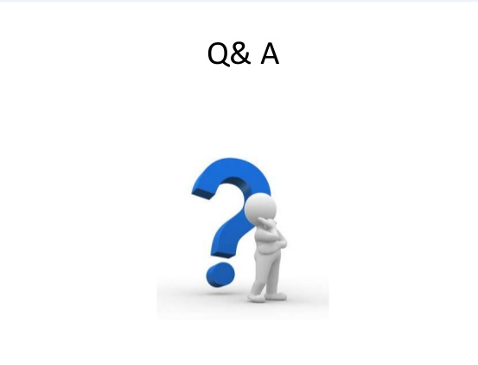
Thank You !!

